Slide 1
MORE PRACTICE WITH CSS
By TEAM 02

Slide 2




Lahari Thamatam
Nithya Vudayamarri
Anusha Kalyankar
Manasa Goriparthi

Slide 3
Repository Link
https://github.com/NithyaVudayamarri/more_practice_with_css
Lahari Thamatam

Slide 4
What is CSS?
Cascading Style Sheets.
It is used for web designing.
CSS is used to describe the look and formatting of a page.
It is generally used with HTML to change the style of web pages.
Lahari Thamatam

Slide 5
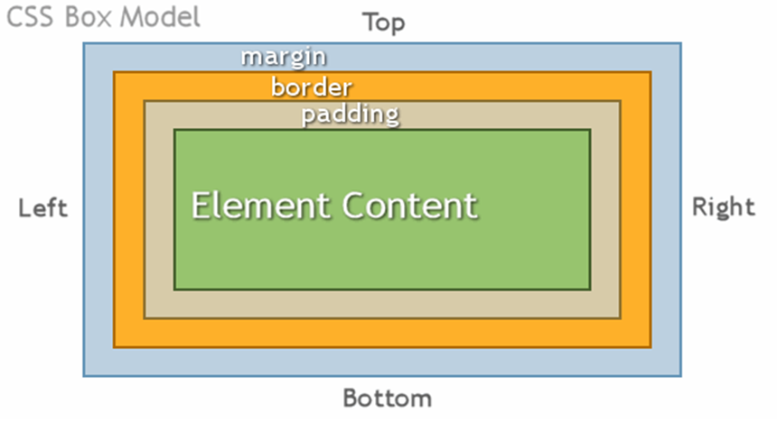
Box Model
Lahari Thamatam

Slide 6
CSS Box Model
Is set of rules that define how every web page on internet is rendered.
Each element in HTML document is treated as a “box” by CSS with different properties.
It determines where it appears on web page.
Lahari Thamatam

Slide 7
CSS Box Model(Contd..)
Element content: here text and images appear .
Padding: area around content which is transparent.
Border: area that borders around padding and content.
Margin: area around border which is transparent.
Lahari Thamatam

Slide 8


Style Rules
Style Rule is of two parts: a selector and a declaration.
TH{color: green;}
Selector is used to indicate the element to which the rule is applied.
Declaration determines the property values of a selector.
Lahari Thamatam

Slide 9
Style Rules(Contd..)
Example:
#para1
{
text-align : center;
color : red;
}
In addition there are class and id selectors.
The id selector is used to style a single element.
It is defined with a ‘#’.
Anusha Kayankar

Slide 10
Style Rules(Contd..)
Example: .center
{ text-align:center;
}
The class selector is used to specify for a group of elements.
It is defined with ‘.’
Anusha Kayankar

Slide 11
Style Rules(Contd..)
Example: .center
{ text-align:center;
}
The class selector is used to specify for a group of elements.
It is defined with ‘.’
Anusha Kayankar

Slide 12
Ways to insert CSS
External style sheet
Internal style sheet
Inline style
Anusha Kayankar

Slide 13
How to Link an External Style Sheet
External style sheet : An external style sheet can change the look of an entire Web site by changing one file. Each page must be linked to the style sheet using the <link> tag.
The <link> tag goes inside the head section:
<head>
<link rel = *stylesheet* type= “text/css” href = “href=“ mystyle.css”/>
</head>
Anusha Kayankar

Slide 14
How to insert CSS in Internal Style Sheet
<head>
<Style type=“text/css”>
hr {color:red;}
p {margin-left:20px;}
Body{background- image:url(“images/back.gif”)
</style>
</head>
Internal Style Sheet : An internal style should be used when a single document has a unique style.
Manasa Goriparthi

Slide 15
How to insert CSS in Inline Style
Inline Styles: An inline style is used to apply a unique style for a single element.
To use inline styles, add the style attribute to the relevant element.
Example:
<h1 style=‘color:blue;margin-left:30px;”>This is a heading</h1>
Manasa Goriparthi

Slide 16
Using Flexbox Froggy
It is a game developed using CSS.
Justify-content is the property used to align the items horizontally.
Manasa Goriparthi

Slide 17
Using Flexbox Froggy(Contd..)
We need to give few values for the moments like
flex-start: Items align to the left side of the container.
flex-end: Items align to the right side of the container.
center: Items align at the center of the container.
space-between: Items display with space between them.
space-around: Items display with equal spacing around them.
Manasa Goriparthi

Slide 18
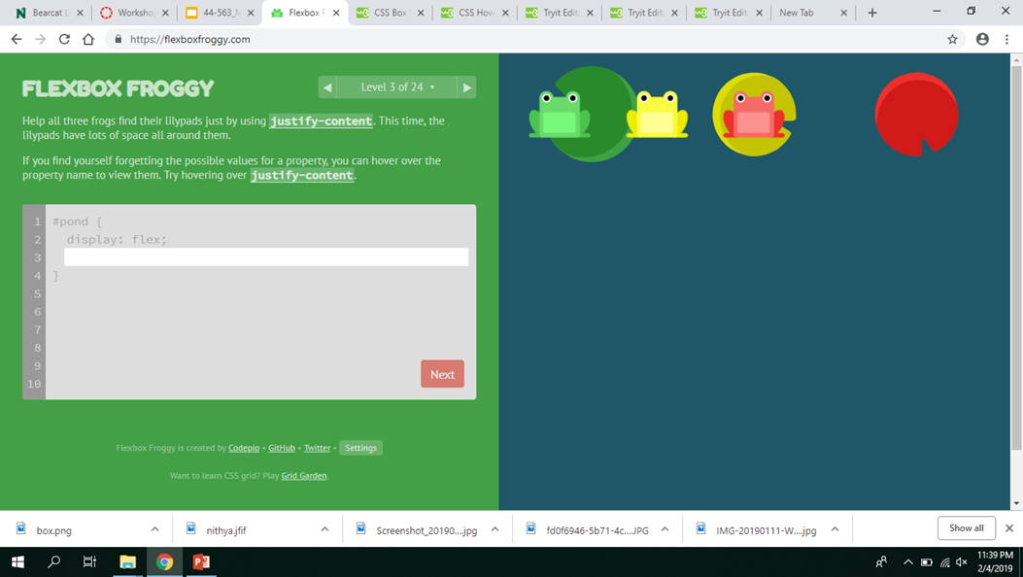
Flexbox Froggy Screenshots
Manasa Goriparthi

Slide 19
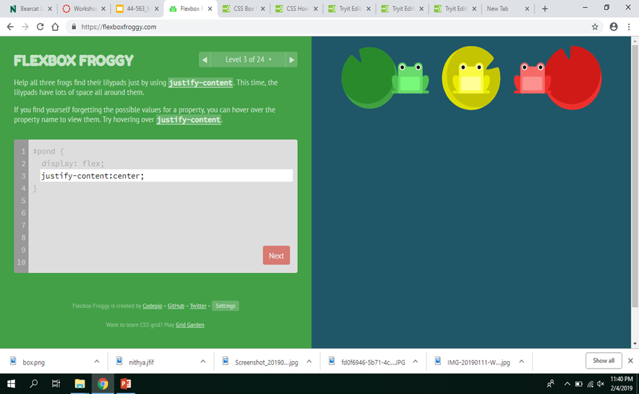
Manasa Goriparthi

Slide 20
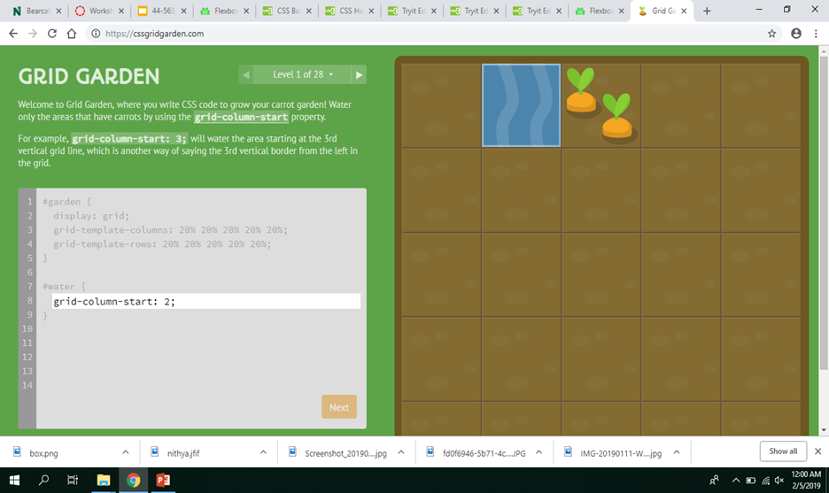
Grid Garden
Nithya Vudayamarri

Slide 21
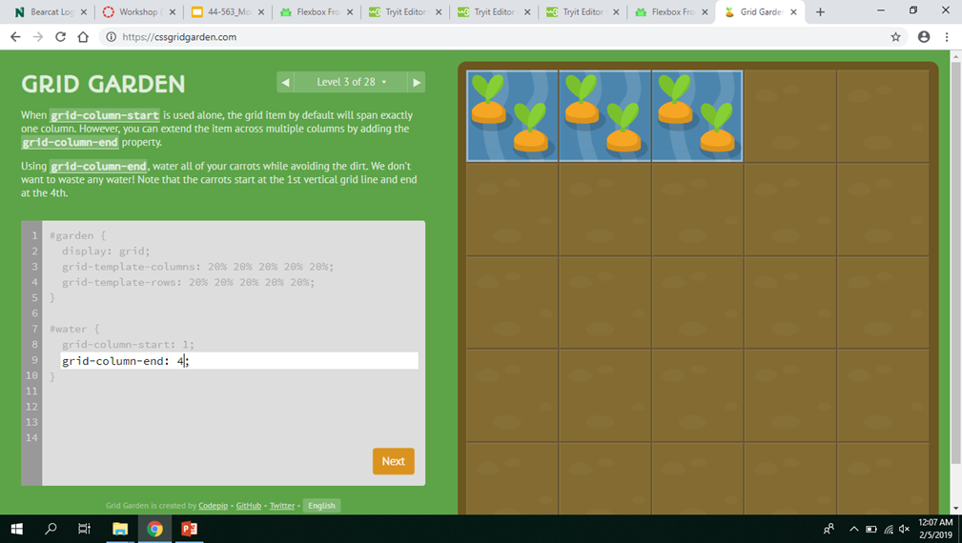
Nithya Vudayamarri

Slide 22
Advantages of CSS:
CSS saves time
Pages load faster
Easy maintenance
Superior styles to HMTL
Nithya Vudayamarri

Slide 23
Demo Time
Nithya Vudayamarri

Slide 24


Slide 25
References
http://kamleshshrestha.com.np/css-box-model/box-model/
https://www.w3schools.com/
https://flexboxfroggy.com/
https://cssgridgarden.com/

Slide 26
Thank You.

